Slide 1

Software Design and Architecture [Software Architecture] – Week 03, L01

Slide 2
Lecture Outlines
Fundamentals of software architecture
  What is software architecture?
  Why is it important?
Key tasks in software architecture
  Stakeholders concerns
  Identify architectural views, styles, and patterns
  Identify major component’s and interfaces
  Evaluating and validating the Architecture
  Introducing policies for design synchronicity
Problem-solving in architecture
What’s next…

Slide 3
1- Fundamentals of Software Architecture
Architecture is:
  All about communication.
  What ‘parts’ are there?
  How do the ‘parts’ fit together?
Architecture is not:
  About development.
  About algorithms.
  About data structures.

Slide 4
Fundamentals of Software Architecture
What is Architecture ?
Refers to the high level structures of a software system, the discipline of creating such structures, and the documentation of these structures.
Architecture captures three primary dimensions:
  Structure
  Communication (behavior)
  Nonfunctional requirements
Focuses on those aspects of a system that would be diﬃcult to change once the system is built.

Slide 5
Fundamentals of Software Architecture
Let’s get straight to the point, formally, we define software architecture as
  (1)The foundational software design activity that evaluates and translates software requirements (both functional and non-functional) into a collection of design elements that specify structural and behavioral aspects of the major components of the system, together with their provided quality and interrelationships required to support the detailed design and construction of software systems.
  (2) and the product resulting from such activity.

Slide 6
Fundamentals of Software Architecture
From this definition, a few things are of interest and need further explanation:
  Foundational design
  Transforming requirements (from textual base into a graphical base)
  Collection of design elements (diagrams)
  Major system components together with their provided quality
  Support (an input to) detailed design and construction
Let’s take a more detailed look at these…

Slide 7
Fundamentals of Software Architecture
On “ … foundational software design…”
  Software architecture provides the groundwork essential for meeting requirements (functional + non-functional)
  This suggest that architecture is not an optional activity, it is a major activity.
  New development efforts should approach software architecture as a forward engineering activity that leads to the implementation of systems and not as a reverse engineering mechanism for documentation.
  As foundational design, it is where designing for quality begins
  Not considering quality attributes of the system during the software architecture activity can be a grave mistake!

Slide 8
Fundamentals of Software Architecture
On “…translates software requirements…”
  Software architecture provides abstractions for software requirements in the design domain
  Design elements (diagrams) need to be created so that there is a mapping between requirements and design element.
    When we do this, we transform requirements from textual form into a graphical form
    This allows us to provide easy means for tracing requirements through the development life-cycle.
  To create design elements from requirements, it is assumed that requirements are understood, however, this is not always the case
    This suggest that architects must be proficient in activities related to requirements engineering.

Slide 9
Fundamentals of Software Architecture
On “…collection of design elements…”
  No one structure or diagram can fully describe the software architecture.
    Think about this: can you evaluate a system’s usability and performance with one diagram?
  This suggest that architectures are composed of multiple structures (or diagrams).
  This is also because architecture design aims for communicating the system structure with different stakeholders. Therefore, different diagrams are required for different stakeholders.

Slide 10
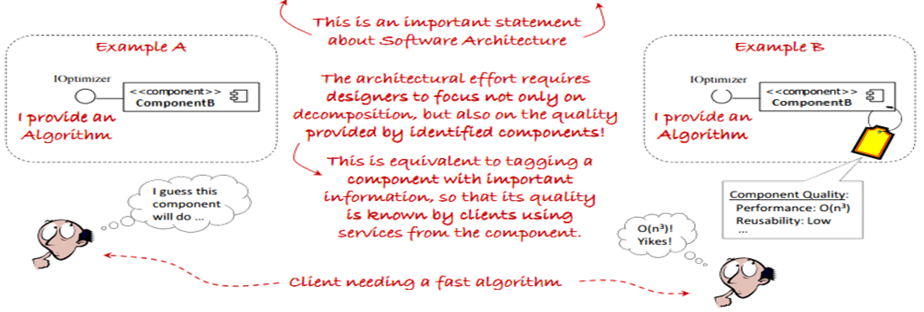
Fundamentals of Software Architecture
On “…major components of the system, together with their provided quality…”
  This means that architectural work focuses on the major components, the quality properties, and services (functionality) that these components exhibit and provide to other components.

Slide 11
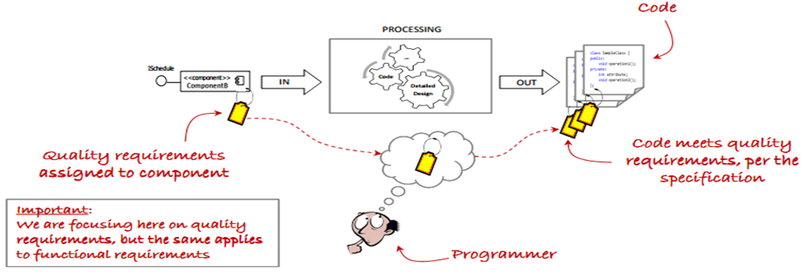
Fundamentals of Software Architecture
More on “…major components of the system, together with their provided quality…”
  Expected quality requirements identified during architecture trickles down all the way to the implementation of components.

Slide 12
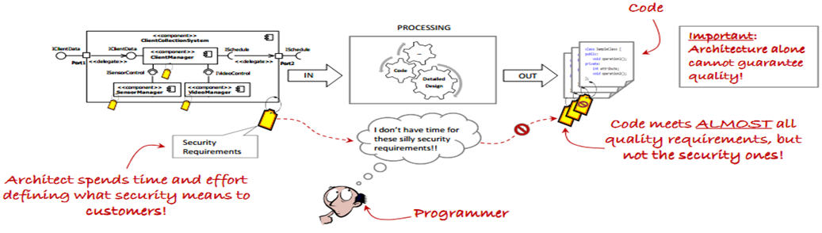
Fundamentals of Software Architecture
On “…support detailed design and construction…”
  Although architecture focuses on the quality properties of the system, it must also result in a design that supports efficient detailed design and construction of the system.
    Architects benefit greatly from having proficiency in general programming design concepts.
  This suggests that architecture alone cannot guarantee the quality of the system!

Slide 13
Fundamentals of Software Architecture
To wrap up …
  Architectural design should be an early stage of the system design process
  Represents the link between specification and design processes
  Often carried out in parallel with some specification activities
  It involves identifying major system components and their communications with required quality attributes

Slide 14
2- Key Tasks in Architectural Design
Formally, key tasks that need to be performed during the software architecture design effort include:
    Identifying stakeholders concern (requirements & quality attributes)
    Identifying appropriate architectural views
    Identifying architectural styles and patterns
    Identifying influences of architectural decisions in organizations
    Identifying the system’s major components and interfaces
    Evaluating and validating the architecture
    Establishing policies for ensuring architectural design synchronicity
Let’s discuss these in more detail…

Slide 15
Key Tasks in Architectural Design
1- Identifying stakeholders concerns
  Stakeholders are persons, groups, or organizations that have a direct or indirect stake or interest in the system.
    They include systems engineers, software engineers, hardware engineers, project management, customers, testing teams, quality assurance teams, members of the configuration management team, etc.
  A stakeholder’s concern provides high-level information about desired characteristics of the software system.
    The software architect must ensure that the software to be developed addresses the concerns of all stakeholders.
    Stakeholders’ concerns serve as driving force behind architectural decisions (important)

Slide 16
Key Tasks in Architectural Design
Identifying stakeholders concerns (cont.)
  The software architect must identify and understand the different ways stakeholders influence the system.
    These need to be elicited before any design effort can begin.

Slide 17
Key Tasks in Architectural Design
Some important quality attributes of software systems that might concern the stakeholders
Quality | Description
Usability | The degree of complexity involved when learning or using the system.
Modifiability | The degree of complexity involved when changing the system to fit current or future needs.
Security | The system’s ability to protect and defend its information or information system.
Performance | The system’s capacity to accomplish useful work under time and resource constraints.
Reliability | The system’s failure rate.
Portability | The degree of complexity involved when adapting the system to other software or hardware environments.
Testability | The degree of complexity involved when verifying and validating the system’s required functions.
Availability | The system’s uptime.
Interoperability | The system’s ability to collaborate with other software or hardware systems.

Slide 18
Key Tasks in Architectural Design
Notice that these quality attributes also describe high-level information about desired characteristics of the software system.
  In their current form, they are insufficient to develop the system.
  For a system to exhibit any of these qualities, design decisions (tactics) must be made to support the achievement of these qualities.

Slide 19







Key Tasks in Architectural Design
The term tactic is a design decision that influences the control of a quality attribute response.
In many cases, these quality attributes are identified through the requirement phase, leaving the architect responsible for specifying how to meet these quality attributes. During this process, tactics are identified for each desired quality attribute. (important)
Tactic #1: Support undoable operations Tactic #2: Provide cancel option
I have some ideas. Let’s discuss so that we can come up with usability requirements.
I want usability!
Customer
Customer
Software Architect
Software Architect

Slide 20
Key Tasks in Architectural Design
Examples on some tactics that relate to the following qualities:
Tactics for Security
  Resisting Attacks: authenticating users, Limit exposure, Limit access, only on need-to-know basis, etc.
  Detecting Attacks: intrusion detection
Tactics for Testability
  Event logging : log data and operations throughout the system. Allow testers to enable/disable this feature so that when enabled, events are displayed in the console to give insight into the system’s operations and data.
Tactics for Modifiability
  Localize changes: modularization, abstraction, encapsulation
  Prevention of ripple effects: encapsulation, reduce coupling
Tactics for Availability
  Redundancy, Task monitor, Watchdog timer , etc.
Tactics for Performance
  Increase computation efficiency, reduce computational overhead, introduce concurrency, etc

Slide 21
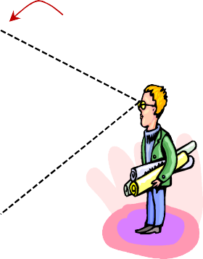
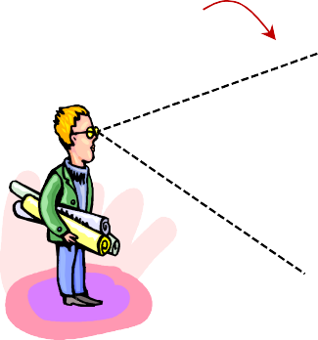
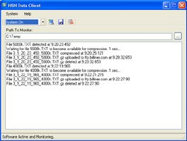
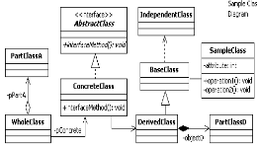
Key Tasks in Architectural Design
2- Identifying appropriate architectural views
  In complex software systems, there can be numerous stakeholders with different backgrounds.
    These stakeholders have different perception about the system, which influence the way they evaluate the system’s design
View 1
The same system from two different views
View 2
This view is appropriate to evaluate the system’s usability
This view is appropriate to evaluate the system’s reusability

Slide 22
Key Tasks in Architectural Design
Identifying appropriate architectural views
  For this reason, architectural designs must support different architectural views used to evaluate the design from a particular stakeholder’s perspective.
  An architectural view is a representation of the system.
    Different representations are required to evaluate certain properties of the system.
View 1
The same system from two different views
View 2
This view is appropriate to evaluate the system’s usability
This view is appropriate to evaluate the system’s reusability

Slide 23
Key Tasks in Architectural Design
3- Identifying architectural styles and patterns
  They provide an overall strategy for designing a family of software systems. (e.g. distributed systems family)
  They provide reusable architectural solutions, documented in a way that is easily understood and applied.
  Decisions based on styles and patterns benefit from years of documented experience.
  The concept of architectural styles and patterns are fundamental to the efficient creation of software architectures.
  Today, numerous styles and patterns exist so architects must be aware of these so that they can identify and determine the appropriateness of a particular style or pattern for their system’s design
  We will discuss major design patters in more details later in the course
  Architects must understand the effect of architectural decisions on customers, budget, schedule, and resource availability

Slide 24
Key Tasks in Architectural Design
6- Evaluating and Validating the Architecture
  Long and iterative process
  Failure to do so can have significant impact in effort and cost incurred to develop the system.
    It is well known that defects found earlier on in the development process take much less effort to correct than if found at later stages.
  The result should determine if the software architecture is sufficiently complete to support the development of the system.
  We’ll have more to say about this later on in the course…

Slide 25
Key Tasks in Architectural Design
7- Introduce policies for design synchronicity
  Design synchronicity is a measurement of the degree of how well the software implementation reflects its design, both in architectural form and detailed design form.
  Obviously, we want high synchronicity, but this is not always the case.
    It is very easy to deviate from design, especially on multi-year efforts.
  For any software architecture effort to result in successful implementation, all subsequent phases and activities must be synchronized with the architecture.
    To do this, a well-defined and understood process must be in place.
    This includes the maintenance phase, which can go on for years after a software has been deployed!

Slide 26
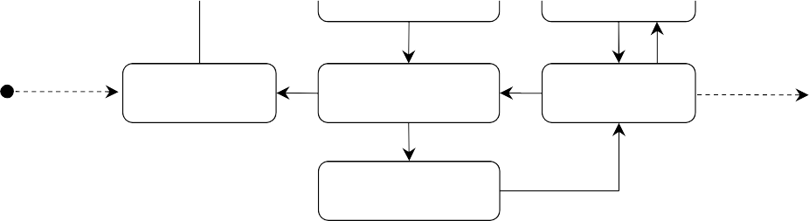
Problem Solving During Architecture
Schedule Constraints, Cost Constraints, Quality Constraints
These define the problem and product constraints
Requirements, System Goals, Scenarios
Evaluate Constraints
Document
Architectural Designs, Documentation
Interpret Problem
Collaborative Brainstorming
Evaluate
Architectural Design
Controls Examples:
Design reviews must be scheduled with one week of anticipation
Software Quality Assurance personnel must be present during review.
Review of material containing classified information must occur inside a vault
Unfortunately, these are rarely complete on the first shot!
Resources
Activities
Controls
Development team, modeling software, IDEs, hardware, etc.
These dictate how, when, and where activities are performed!
Tasks performed to process the requirements Example: Design Review

Slide 27
Summary
This session, we presented fundamentals concepts of software architecture and key tasks that need to be performed during software architecture, including:
  Identifying stakeholders concerns (requirements)
  Identify architectural views, styles, and patterns
  Identify major component’s and interfaces
  Evaluating and validating the Architecture
  Introducing policies for design synchronicity
We’ve also mentioned issues with software quality and requirements (but not in details)
Next session will focus on requirements engineering, providing enough information to successfully create good requirements.

